Slide 1
MER311: Advanced Strength of Materials
LECTURE OUTLINE
Strength of Materials Review
Stress at a Point
2D Mohr’s Circle

Slide 2









Example
Continuation
z
Given that the cross-section of this structure is circular with a radius of 0.1m, find the maximum normal and shearing stresses.
A
3m
x
B
y
C
3m
2m
D

Slide 3
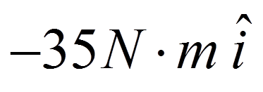
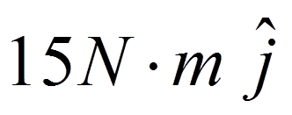
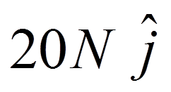
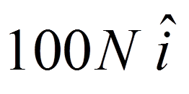
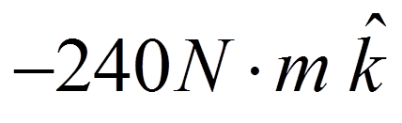
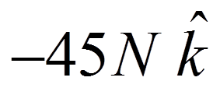
At the Wall
z
A
y
x

Slide 4
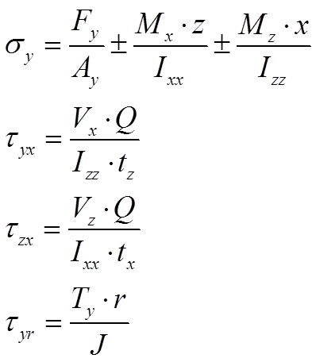
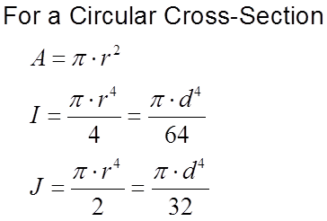
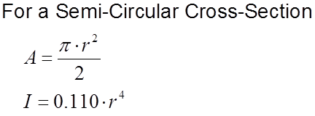

Calculating the State of Stress Using Strength of Materials

Slide 5
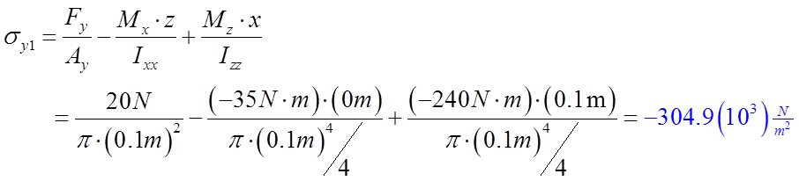
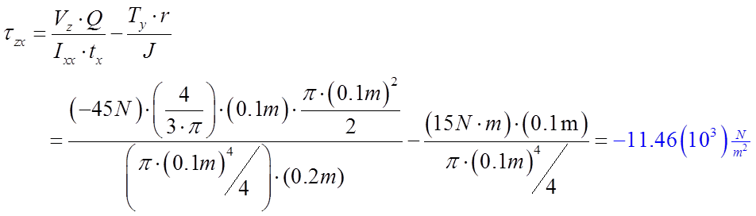
Forces and Couples Related to Normal and Shear Stress @ 1
Normal Stress
Shear Stress
z
τ_{yz}=-11.5 kPa
z
σ_{y}=-305. kPa
x
1
1
A
A
x
y
y
5
RBB

Slide 6
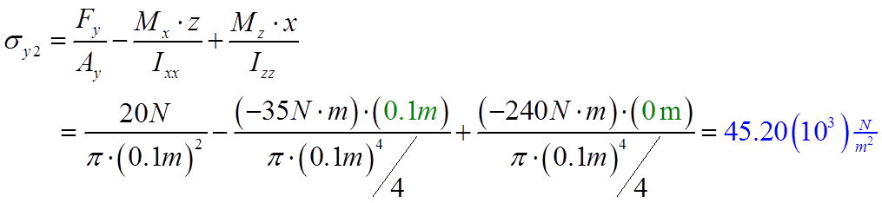
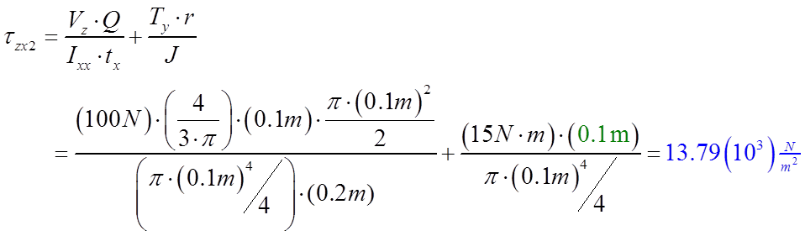
Forces and Couples Related to Normal and Shear Stress @ 2
Normal Stress
Shear Stress
z
z
τ_{yx}=13.8 kPa
2
2
σ_{y}=45.2 kPa
x
x
A
A
y
y
6
RBB

Slide 7
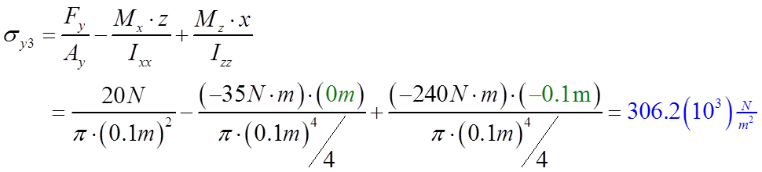
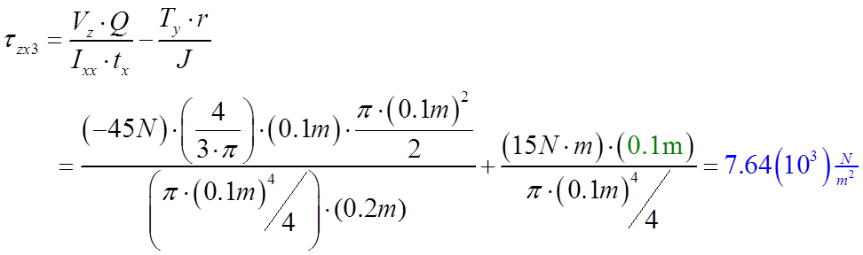
Forces and Couples Related to Normal and Shear Stress @ 3
Normal Stress
Shear Stress
z
τ_{yz}=7.64 kPa
z
σ_{y}=306. kPa
x
3
A
3
A
x
y
y
7
RBB

Slide 8
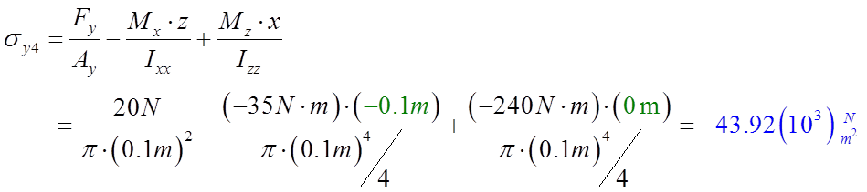
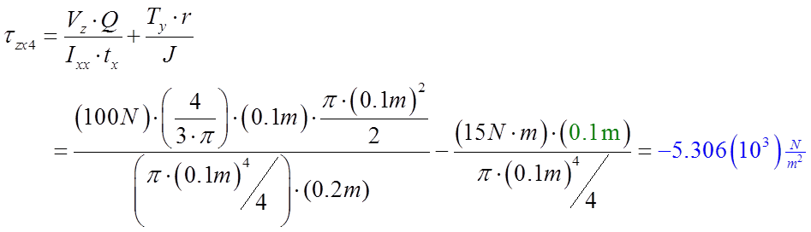
Forces and Couples Related to Normal and Shear Stress @ 4
Normal Stress
Shear Stress
z
z
τ_{yx}=-5.3 kPa
σ_{y}=-43.9 kPa
x
x
A
A
4
4
y
y
8
RBB

Slide 9
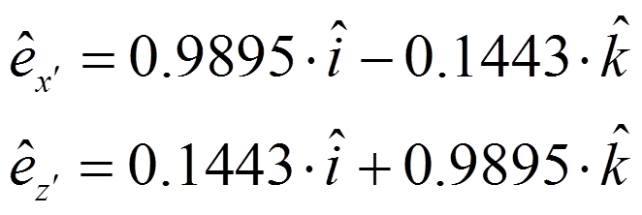
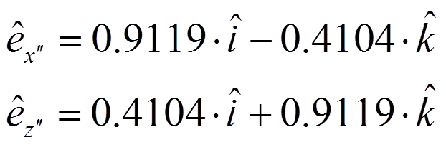
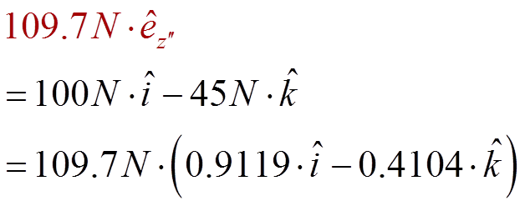
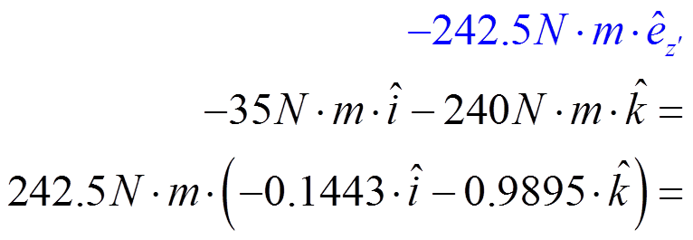
For the Circular X-Section Maximum Stresses
Normal Stress
Shear Stress
z’
z
z’’
z
Neutral
Axis
6
x
x
A
A
x’
5
x’’
y
y
9
RBB

Slide 10
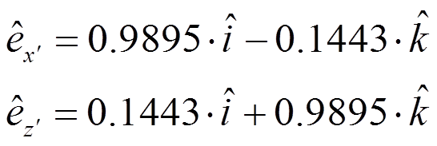
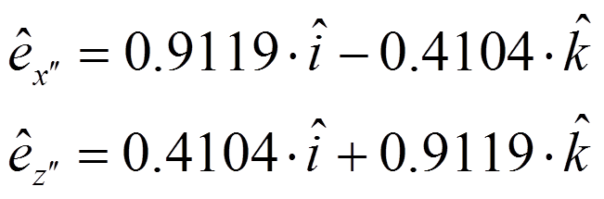
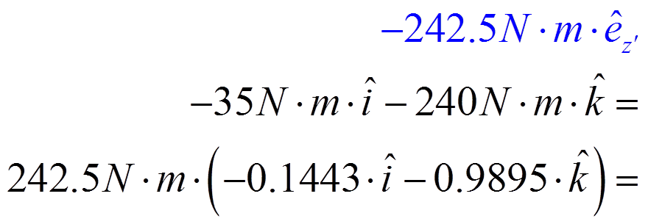

Only a Component of the Shear Stress Important
Normal Stress
Shear Stress
z’
z
z’’
z’
z
Neutral
Axis
6
x
x
A
A
x’
5
x’
x’’
y
y
10
RBB

Slide 11
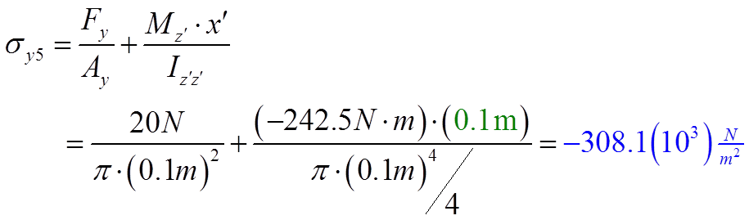
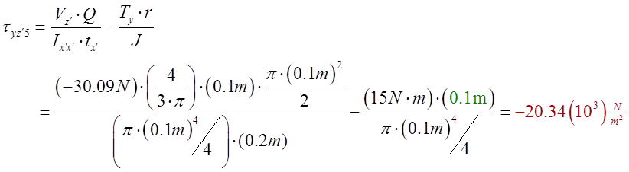
Forces and Couples Related to Normal and Shear Stress @ 5
Normal Stress
Shear Stress
z’
z
τ_{yz’}=-20.3 kPa
z’
z
Neutral
Axis
σ_{y}=-308 kPa
6
6
x
x
A
A
x’
5
x’
5
y
y
11
RBB

Slide 12
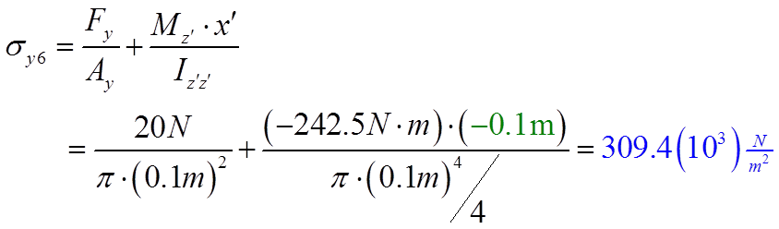
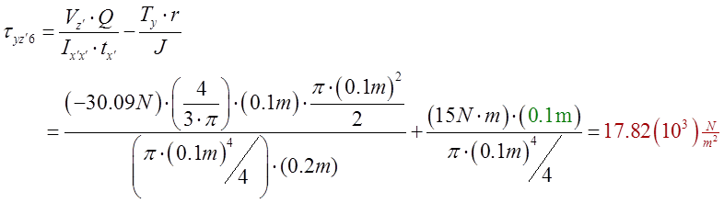
Forces and Couples Related to Normal and Shear Stress @ 6
Normal Stress
Shear Stress
z’
z
τ_{yz’}=17.8 kPa
z’
z
Neutral
Axis
σ_{y}=309 kPa
6
6
x
x
A
A
x’
x’
y
y
12
RBB

